Slide 1
Indiana State Dairy Association
Elizabeth Straw – Executive Secretary
270 South Russell St
West Lafayette, IN 47907
(765) 494-8025
Efarrow@purdue.edu

Slide 2
Register For DHIR With ADGA
Annual New Herd Test Fee
1-5 Does $45.00
6-25 Does $50.00
26+ Does $75.00
ADGA Plus Enrollment & 3 DNA Tests $70
January 31st Deadline Does Not Apply to New Herds

Slide 3
Register For DHIR With ADGA
Name of DHIA - Indiana State Dairy Association
DPRC - DRMS (Raleigh)
Herd Code # - Assigned By ISDA Once Contact Information Is Provided

Slide 4
Test Types
DHIR 20 – Supervisor weights and samples both milkings on test day. Verification Test required for Top Ten Awards.
DHIR 22 – Supervisor collects both test day weights. Supervisor also collects component samples alternating AM and PM samples each month. Annual herd Verification Test and minimum DCR of 93 required for Top Ten Awards.
DHIR 40 O/S – Owner/Sampler weighs and samples each month and is responsible for sending in samples and paperwork.
For Star Recognition – A minimum DCR of 75 is required plus a herd verification test when the herd is 60-150 Days in Milk.
For Advanced Registry – Requirements for Star recognition. In addition the animals must have 240 days in milk, 8 tests and the owner must provide documentation to ADGA regarding training. This is for those interested in 10 months of testing each year.

Slide 5
DHIR Certification With ISDA
Certification Is Valid For 2 Years
Certification Costs $30
Confirmation Of Certification Will Be Faxed To ADGA And Mailed To Individual

Slide 6
Herdcode Information
32185500
First Two Digits Are The State
32 – Indiana
Second Two Digits Are The County
18 – Delaware
Last Four Digits Are Random
Assigned By DHIA Service Affiliate

Slide 7
Required Testing Information
Doe Registration Number & Breed
Index/Tag Number For Doe
Date of Birth
Dam & Sire Registration Numbers
Kidding Date

Slide 8
Approved Scales
Scales Must Be Calibrated Annually
Scale Calibration Is $5 Plus Shipment Back
Free Calibration At Indiana State Fair
Approved Scales: http://www.quality-certification.com/approved_devices.asp#scales
ISDA Sells Calibrated AWS H110 Scales For $25 Plus Shipping

Slide 9
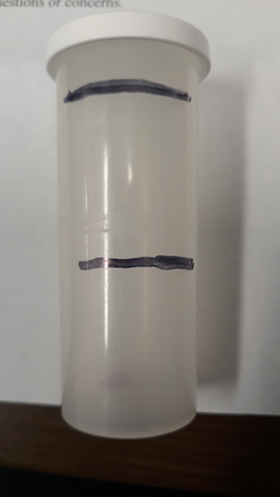
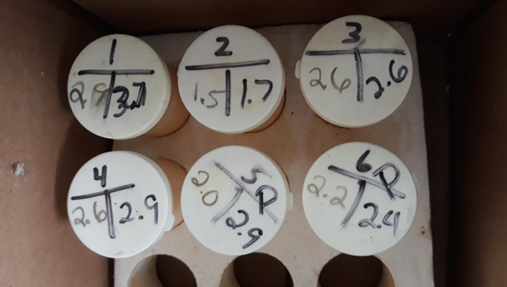
Weighing & Sampling Milk
Tare Scale To Bucket Or Record Weight Of Bucket
Weigh And Record Milk Weights
Easiest Is To Write Weights And Sample Number On Vial Then Transfer To Paperwork After Milking (See Below)
Agitate Milk Sample By Stirring
Fill Vial Halfway with Agitated Milk
Repeat During Second Milking - Keeping The Sample Volume Below Maximum Fill Line

Slide 10
Agitating and Storing Samples
After Sampling, Gently Invert Vial To Mix Preservative
Sample Should Turn Orange In Color
Place Samples In Sample Order From Left To Right, Top To Bottom
Top Row Of Samples Will Be 1-10
Store Samples In Cool Environment (70˚ Or Below)

Slide 11
Sending Test Day Off
Send Test Day Papers To ISDA
Email Them To efarrow@purdue.edu Or Mail to ISDA At The Address Below
270 S Russell Street, West Lafayette, IN 47907
Before Shipping Samples, Write Herdcode On The Side Of First Vial
Ship Samples To DHI Coop
If Shipping Via UPS – 1224 Alton-Darby Creek Rd, Columbus, OH 43228
If Shipping Via USPS – P.O. Box 28168, Columbus, OH 43228
Ship With Sample Shipment Report
ISDA Offers PrePaid UPS Ground Labels For Herds Under 60 Does For $10

Slide 12
Post-Test Date
Sample Box Should Come Back From The lab
Large Packet From The Processing Center (DRMS) Should Arrive With Your Results And Lactation Records
Standard Envelope From ISDA With Invoice, UPS Label, And Additional Reports Should Arrive

Slide 13
Verification Test
Required For Most Test Plans
Between 60 and 150 Days In Milk
Must Be Performed By A Supervisor That Is Not The Regular Supervisor
Supervisor Must Attend 3 Consecutive Milkings
Supervisor Must Verify Identification (normally Tattoos) On All Animals
AGDA’s Verification Form Must Be Completed And Mailed To ISDA

Slide 14
Round Robin
Requires At Least Three DHIR Certified Supervisors
A Tests B, B Tests C, C Tests A
Verification Tests Require Supervisor Outside Of Circle (For Groups Of 3)
For Groups Larger Than 3, A Supervisor Other Than The Regular Supervisor Can Perform VT
Owners Are Eligible For Test Types 20 & 22

Slide 15
Questions?
Elizabeth Straw – Executive Secretary
270 South Russell St
West Lafayette, IN 47907
(765) 494-8025
Efarrow@purdue.edu

